Slide 1
Devleoping analaysis Classes
Lecture

Slide 2
Analysis Classes
Analysis classes are generated from analysing the Use Case Model.
There are just 3 analysis classes available for analysing the Use Case Model:
Boundary,
Controller
and Entity.

Slide 3
Consider the Automated Library System
1. Borrow Book
3. Check Fines Due
Student Database
Student
2. Book Provided
4. Update Book Record
Library Database
Automated Library System

Slide 4
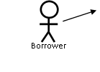
Start by Analysing one Actor-Use Case Pair
Initially choose a use case and use case narrative to analyse
Identify any actor related to the use case such as the borrower
Note that having only one Actor per use case makes this analysis straight forward

Slide 5
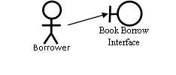
Identifying Boundary Classes
The actor is then added to the Analysis Class diagram as is an appropriate boundary class

Slide 6
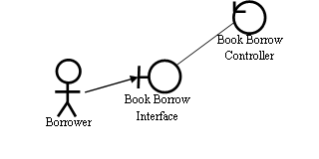
Identifying Core Functionality
Consider the scenario analysis (use case narrative) related to the use case.
Identify any information that is being requested from or input by the actor.
Information will be collected from the interface using a controller

Slide 7
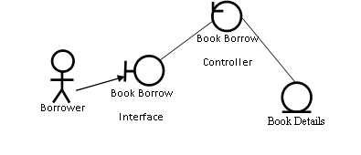
Consider Data
Information is represented by an entity class
so the data collected requires to be stored in an entity class and that is added to the Diagram

Slide 8
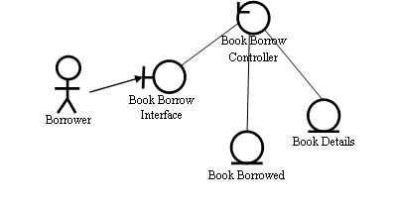
Post-condition: Outcome from Use Case
Having created the basic information exchange analysis model the use case narrative can be further analysed.
The result or post conditions can be considered
The post condition for the use case is that the book is or is not borrowed

Slide 9
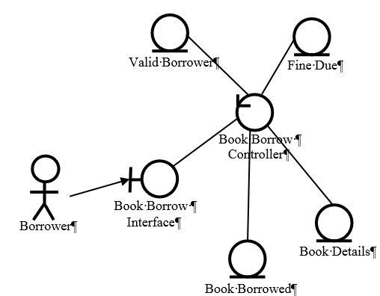
Adding Pre-Conditions
Pre conditions from the use case narrative can then be considered`
The precondition of valid borrower can be added. This could a Boolean type attribute that indicates either true or false
The precondition of Fine Due can then be added. This could a Boolean type attribute that indicates either true or false

Slide 10
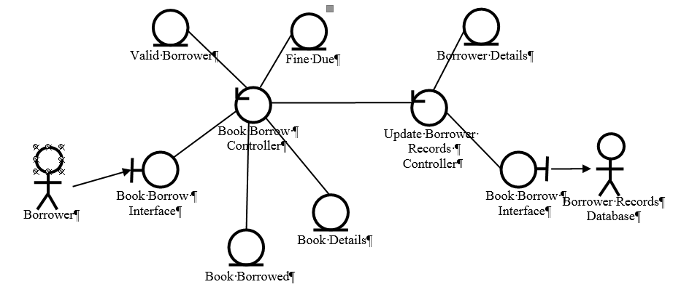
Then a Second Actor-Use Case Pair can be considered
Consider the updating Borrower records Use case and Actor
The Boundary, Entity and Controller can be identified and added. A precondition can be considered

